Slide 1
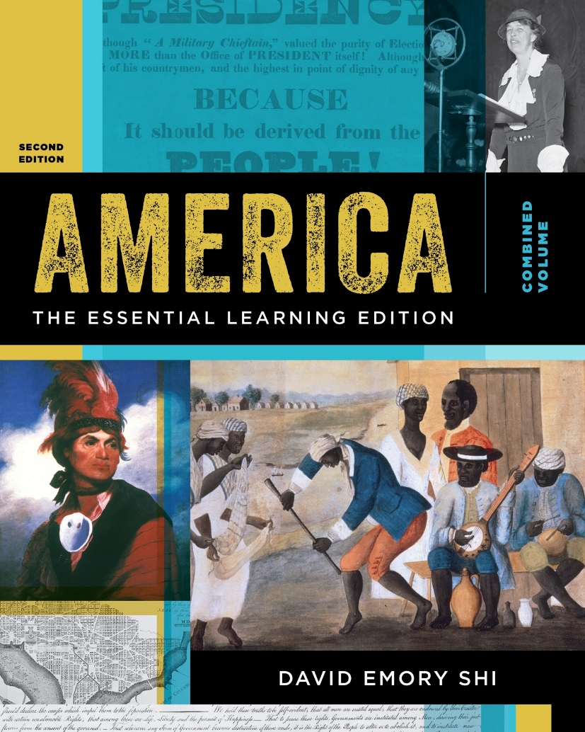
America: The Essential Learning Edition, Second Edition
David Shi
© 2018 W. W. Norton & Company, Inc.

Slide 2
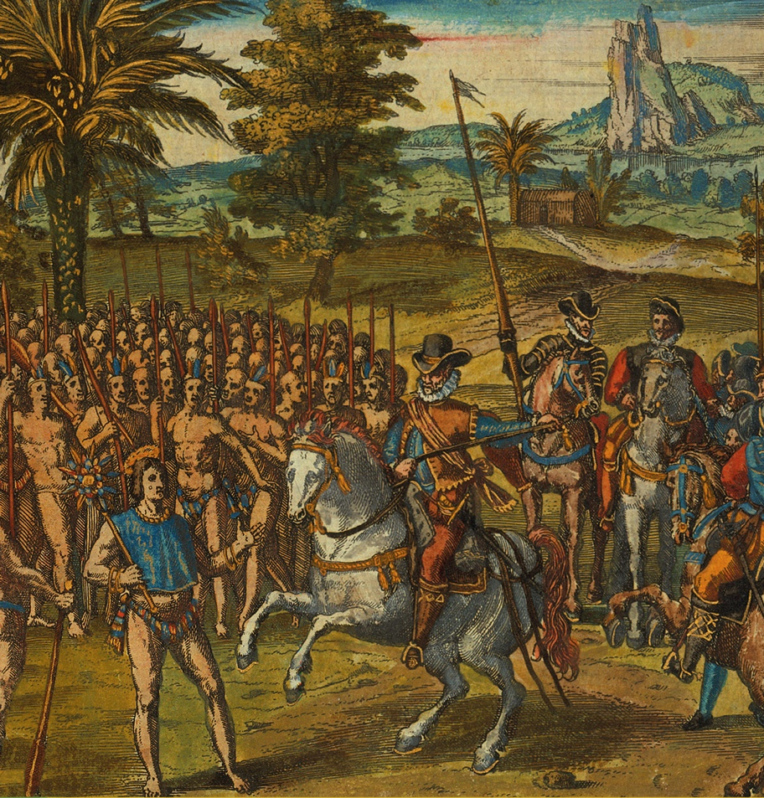
Chapter 1
The Collision Of Cultures in the 16th Century
bpk, Berlin/Kunstbibliothek Staatliche Museen/Knud Petersen/Art Resource

Slide 3
The Collision of Cultures in the 16th Century
Core Objectives
Explain why there were so many diverse human societies in the Americas before Europeans arrived.
Summarize the major developments in Europe that enabled the Age of Exploration.
Describe how the Spanish were able to conquer and colonize the Americas.
Assess the impact of the Columbian Exchange between the “Old” and “New” Worlds.
Analyze the legacy of the Spanish form of colonization on North American history.

Slide 4
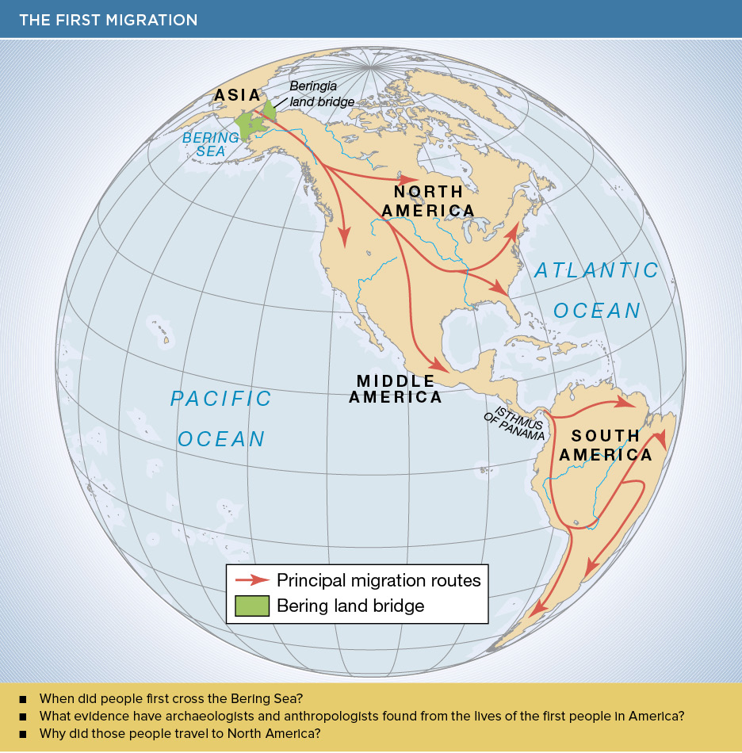
The First Migration

Slide 5
Early Cultures in the Americas
Clovis people
Hunters and gatherers
Changes
Global warming
Agricultural revolution

Slide 6
Mayas, Incas, and Mexica
Mayas
Central America
Highly developed society
Incas
Andes Mountains
Highly developed society
Mexica or Aztecs
Mexico
Tenochtitlán

Slide 7
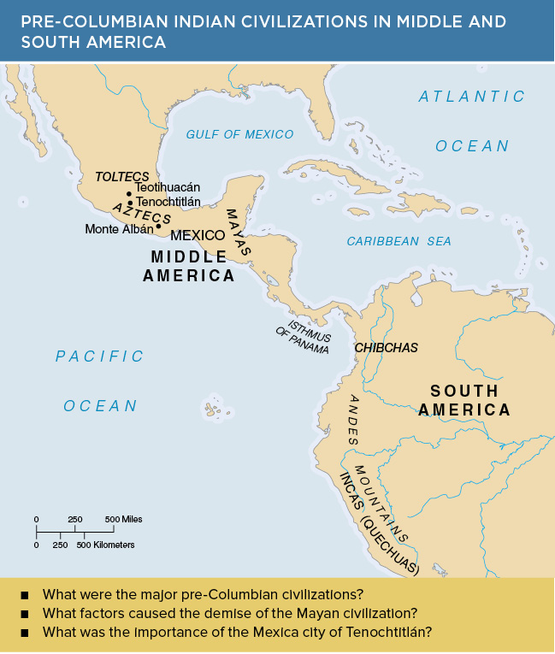
Pre-Columbian Indian Civilizations in Middle and South America

Slide 8
North America Civilizations before 1500
Three distinct civilization trends emerged
Adena-Hopewell culture
Midwest: 800 b.c.e.–400 c.e.
Mississippian culture
Cahokia
Anasazi culture
Pueblo

Slide 9
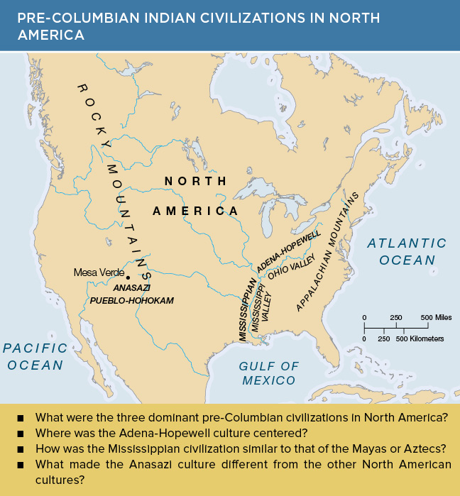
Pre-Columbian Indian Civilizations in North America

Slide 10
Native Americans in 1500
Eastern Woodlands peoples
Atlantic seaboard
Algonquian
Iroquoian
Muskogean

Slide 11
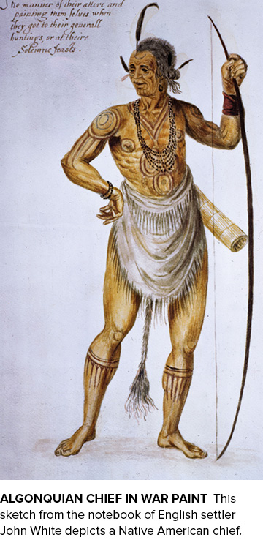
Algonquian Chief in War Paint
MPI/Getty Images

Slide 12
The Expansion of Europe
Reasons for expansion
Decline of feudalisms and rise of middle class
Rise of nation-states
Renaissance
Rise of global trade

Slide 13
The Voyages of Christopher Columbus
Christopher Columbus
His voyage of discovery in 1492
Later voyages
America named for Amerigo Vespucci

Slide 14
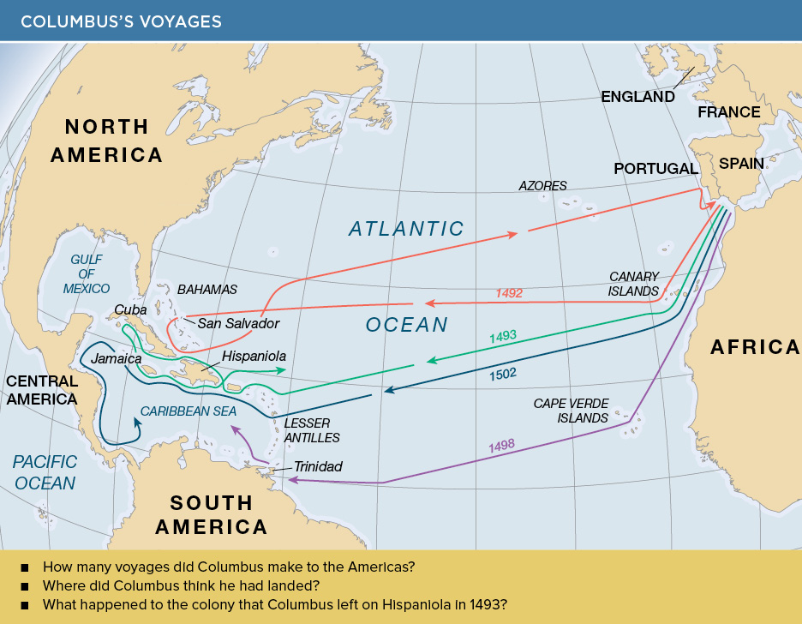
Columbus’s Voyages

Slide 15
Professional Explorers
Columbus and Vespucci inspired other explorers
John Cabot, 1497, in England
Newfoundland

Slide 16
Religious Conflict in Europe
Roman Catholicism
Martin Luther
The Protestant Reformation
The Protestant Reformation in England
Henry VIII
Elizabeth I

Slide 17
The Spanish Empire
Treaty of Tordesillas
A clash of cultures
Spanish invaders
Hernán Cortés
Aztecs
Francisco Pizarro
Peru

Slide 18
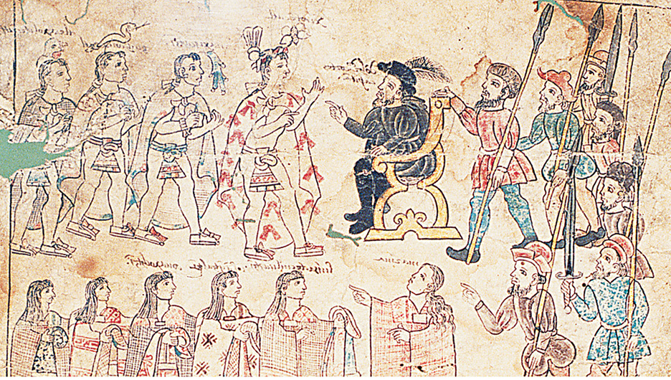
Cortés in Mexico
Nettie Lee Benson Latin American Collection, University of Texas Libraries, The University of Texas at Austin

Slide 19
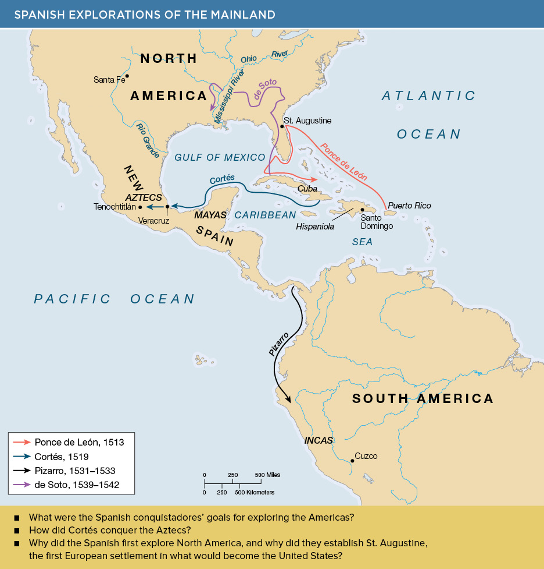
Spanish Explorations of the Mainland

Slide 20
Spanish America
Growth of civilizations in the New World
Implementation of the encomienda system
Subjugated Native Americans

Slide 21
The Columbian Exchange
The Great Biological Exchange
Animals
Plants
Devices and pastimes
Infectious diseases
Consequences of the exchange

Slide 22
Spanish Exploration in North America
Spanish exploration in North America
Differences between Spanish America and North America
The encomienda system
Spanish explorers
Juan Ponce de León
Hernando de Soto
Pedro Menendez de Aviles

Slide 23
The Spanish Southwest
The role of the missions
Juan de Oñate and New Mexico
Popé’s rebellion, 1680
Horses and the Great Plains

Slide 24
French Exploration of America
Search for the “Northwest Passage”
Giovanni da Verrazano explored the coast in 1524
Jacques Cartier made three voyages to establish colonies

Slide 25
Dutch Exploration of America
Protestant Dutch revolt
Dutch and English sea dogs

Slide 26
Defeat of Spanish Armada
English-Spanish rivalry
Philip II of Spain
The defeat of the Armada by the British
Consequences
Beginning of England’s naval supremacy
Cleared way for English colonization of America

Slide 27
English Exploration of America
English exploration
Sir Humphrey Gilbert and Sir Walter Raleigh
The Lost Colony of Roanoke

Slide 28
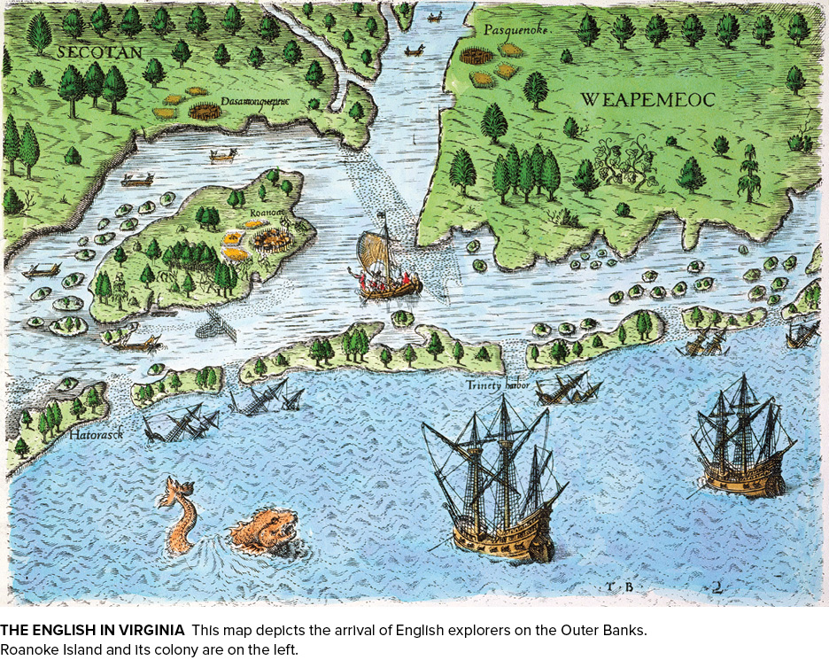
The Arrival of the English in Virginia
Granger, NYC — All rights reserved

Slide 29
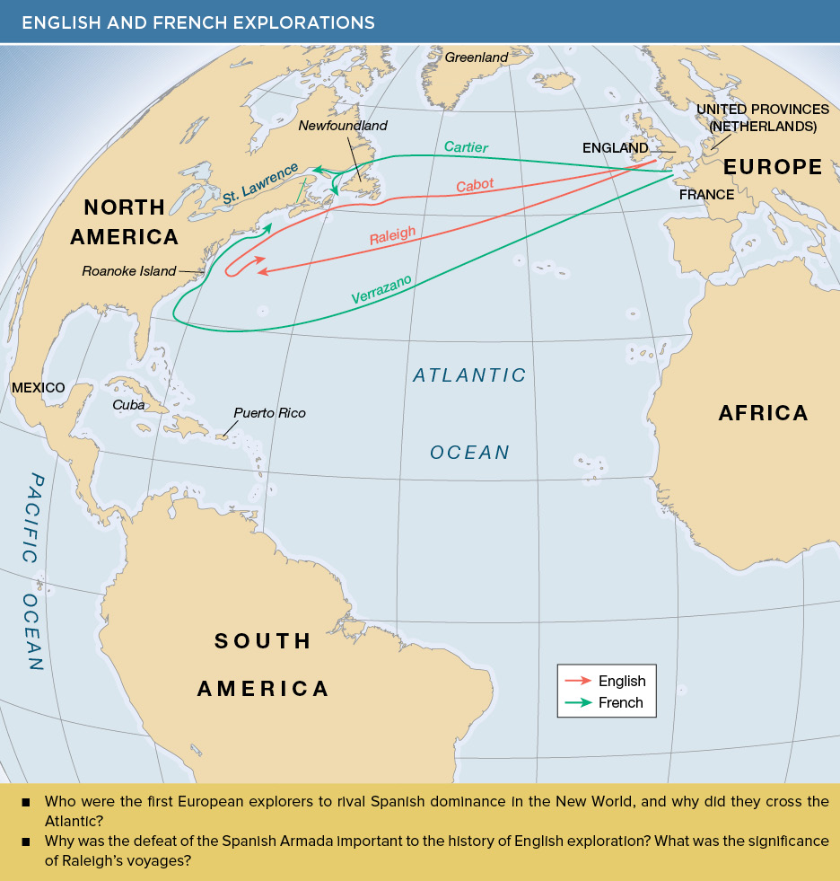
English and French Explorations

Slide 30
New Spain at Its Height
Legacy
Connected cultures of Europe and the Americas
Converted native peoples to Catholic faith
Economic exploitation
Subjugated native people
Instituted African slavery in the New World

Slide 31
This Concludes the PowerPoint Presentation for
Chapter 1
The Collision of Cultures in the 16th Century

